Slide 1



Blossom Bank Case Study- Online Payment Fraud Detection System
Developed by- Mary Makanjuola

Slide 2


Content
Introduction
Problem to be solved
Methodology-
Exploratory data
Future engineering
Conclusion

Slide 3
Introduction
Blossom Bank also known as BB PLC is one of the prestigious bank in the United Kingdom.
The bank is a multinational financial services group, that offers retail and investment banking, pension management, asset management and payments services, headquartered in London, UK.
The bank is known for its financial rigor and stability over decades.
Based on the latest mode of money transfer via online the bank deployed to leverage on this platform as a boost to its services provided.

Slide 4
Problem
There is a need to stop the continuous complaints of customers on fake transactions hence the bank wants to build a Machine Learning model to predict online payment fraud.
In resolving this problem the bank stands to gain its customer’s trust and also stand out among other financial institutions in the United Kingdom,

Slide 5
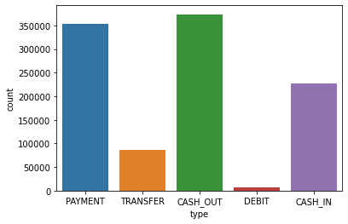
Exploratory data analysis

Slide 6
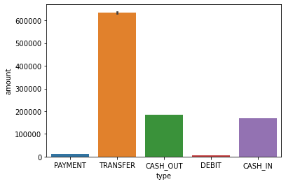
Cash out and Payment are the most common type of transactions, but Transfer type has the maximum amount of money being transferred to the recipient.

Slide 7
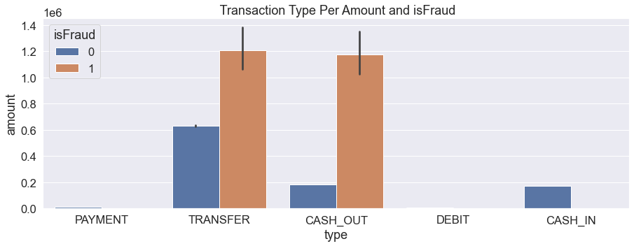

Slide 8


Future engineering
Two models were employed- Logistics Regression, decision Tree Classifier
Logistics regression model results:
99.89962568247384% of the Transaction is Non-Fraud
0.10037431752616044% of the Transaction is Fraud
Decision Tree Classifier result:
100.0% of the Transaction is Non-Fraud
0.0% of the Transaction is Fraud

Slide 9
Conclusion
Blossom bank stands to gain more insight into its online transaction service using the proposed two models. Although there are other models but these two is more appropriate and near accuracy for the predictions.
Finally considering the rate of fraud and money laundering in the society the bank has taken a step higher in resolving such issues, also preventing a futuristic calamity.

Slide 10

Thank you!!!

